Slide 1

Smart Sprinkler System Demo

Slide 2
Completed Artifacts
Technical Design Artifacts:
IoT Integration Architecture Diagram
Code Artifacts:
National Weather Service Integration Module
Backend to Controller Integration Service
Controller to Backend Integration Service

Slide 3


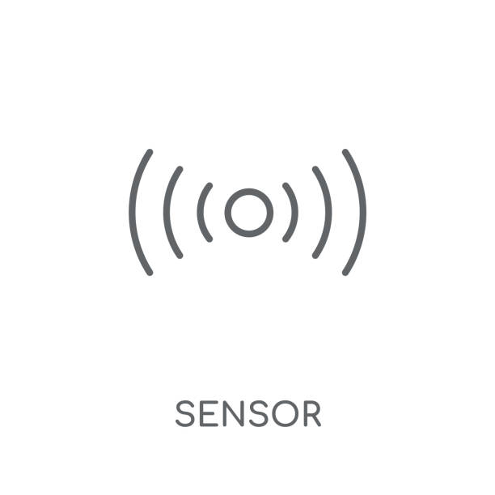



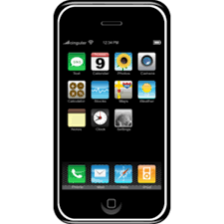
Smart Sprinkler System IoT Integration Architecture
Connected "Things"
IoT Gateway
IoT Integration Hub
API Gateway and Analytics
Data Management

Slide 4
Code Review

